Slide 1

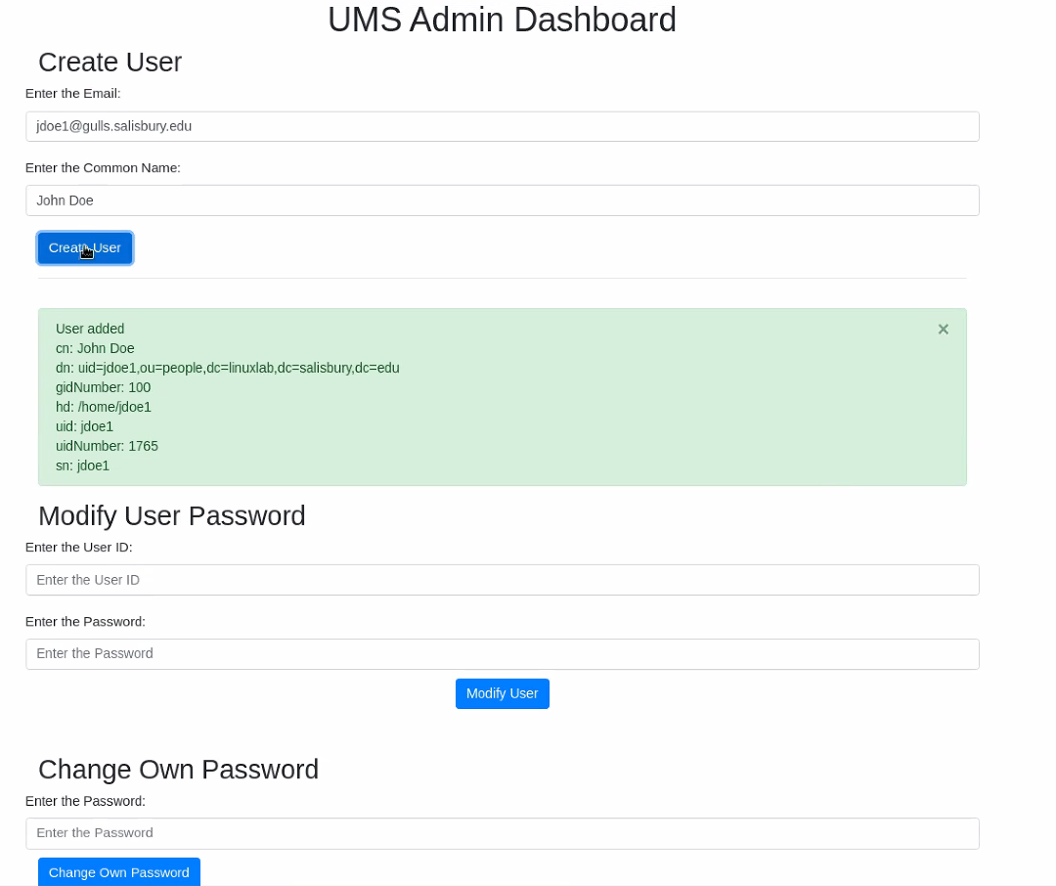


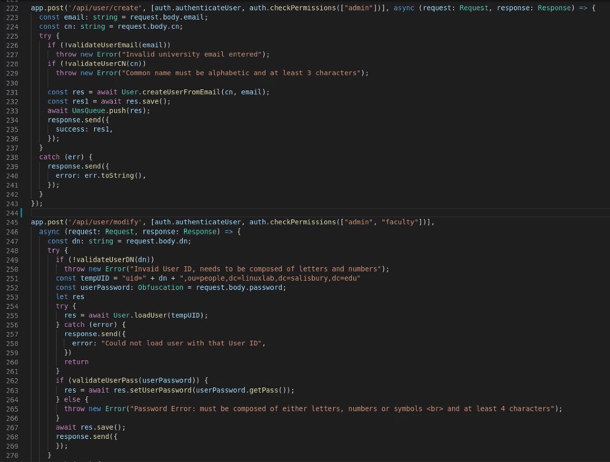

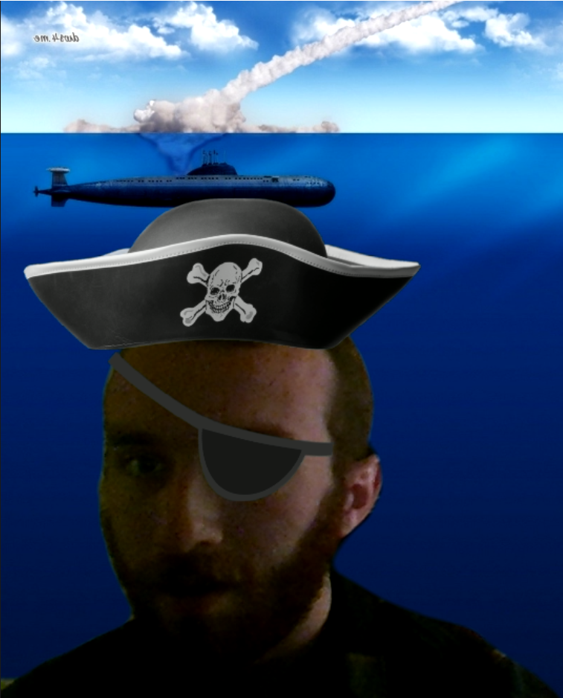


High Performance Computing Lab
User Management System
Team However: Part 2 - Section A
Technologies:
Docker
Typescript
LDAP/LDAPJS
NodeJS
Postman
PASETO
Express
HTML/CSS
Apache Directory Studio
Trello
Zoom
Experience Gained:
Workflow:
Team web-app development
Remote work conduct
General project management
Pair programming dynamics
Technological Concepts:
Model-View-Controller Architecture (MVC)
Container software
Web routing
Transactional client-server security
Functionalities:
Add, load, create and delete user accounts for the HPCL
Backend interface for LDAP database of user accounts
Automatically create home directories for new users
Secure password reset system using authentication tokens
Captain
Helmsman
First Mate
Quartermaster
Michael Mandulak
Dan Weitman
Ian Thomas
Billy Wolf

